Slide 1
PARKING REGISTRATION

Slide 2

HELLO!
We are
Jauharil Firdaus Bassam
Muhamad Luthfi Mufadel
Muhammad Wito Malik

Slide 3

WHAT IS IT?
?

Slide 4

OUR BACKGROUND & GOALS

Slide 5
OLD SYSTEM
COMPLICATED
Old system uses offline concept for UI members who want to register at FTUI park. This is very complicated because everyone have their own business, and not necessarily have time to come, especially for overseas students.
HARD TO UPDATE
The old system does not allow to update the registration data so that person who changes their motorbike will be considered as foreigners.
HIGH RISK
Paper documents have a very high probability of being lost, it is very fatal especially if verification process has not been completed.

Slide 6
OUR NEW SYSTEM
SIMPLE
UI members who want to register only need to open our website and upload required documents via mobile or computer anytime and anywhere.
EASILY UPDATE AND REALTIME
With a web-based system, each student can update data whenever needed, if it has been confirmed by our team it will update to the database realtime.
MINIMUM RISK
Online documents are very safe, can be stored in a long term, and can be accessed again if needed.

Slide 7

For who?

Slide 8

December 30th 2018
The website will be launched

Slide 9

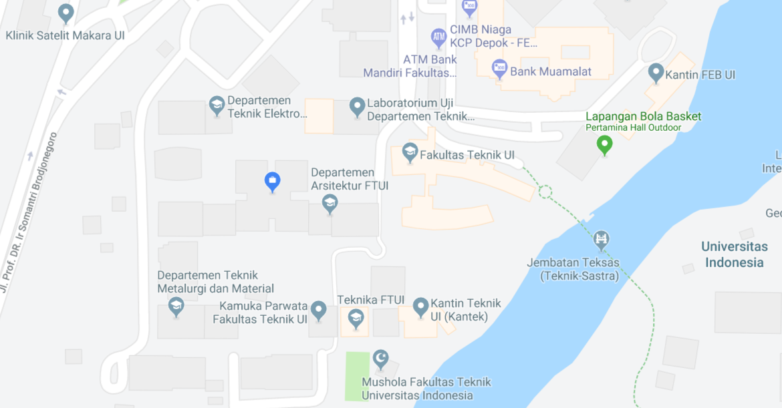
Location
Here

Slide 10

STEPS TO REGISTER
REGISTER YOUR ACCOUNT & WAIT EMAIL FROM US
LOGIN
FILL THE FORM AND UPLOAD THE FILE THAT NEEDED
Insert your UI email
we will send your password via email
Login with your UI email and password
Change your password if needed
Use your NPM or Employee number and Number plate of your motorcycle
Upload your KTM or Employee card and STNK

Slide 11

OUR TIMELINE
Duration | Duration | Start | Finish | Leader
Planning | 3 days | 8/10/2018 | 11/10/2018 | Fadel
Survey | 7 Days | 12/10/2018 | 19/10/2018 | Bassam
Design UI | 4 Days | 20/10/2018 | 24/10/2018 | Wito
Develop and Design | 10 Days | 25/10/2018 | 4/11/2018 | Wito
Testing and Implementation | 10 Days | 5/11/2018 | 15/11/2018 | Fadel
Deployment and Maintenance | 14 days | 16/11/2018 | 30/11/2018 | Bassam

Slide 12
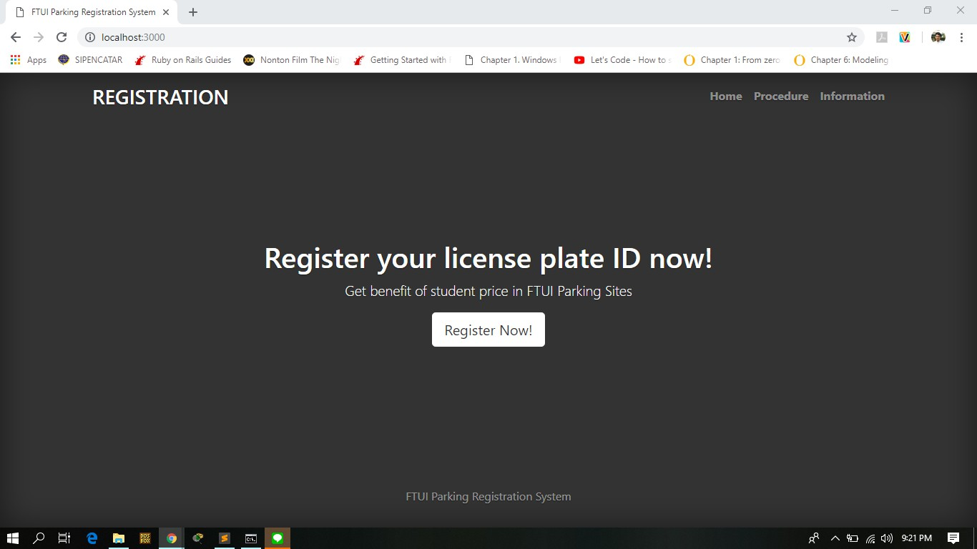
DESKTOP
Place your screenshot here

Slide 13
THANKS!

Slide 14
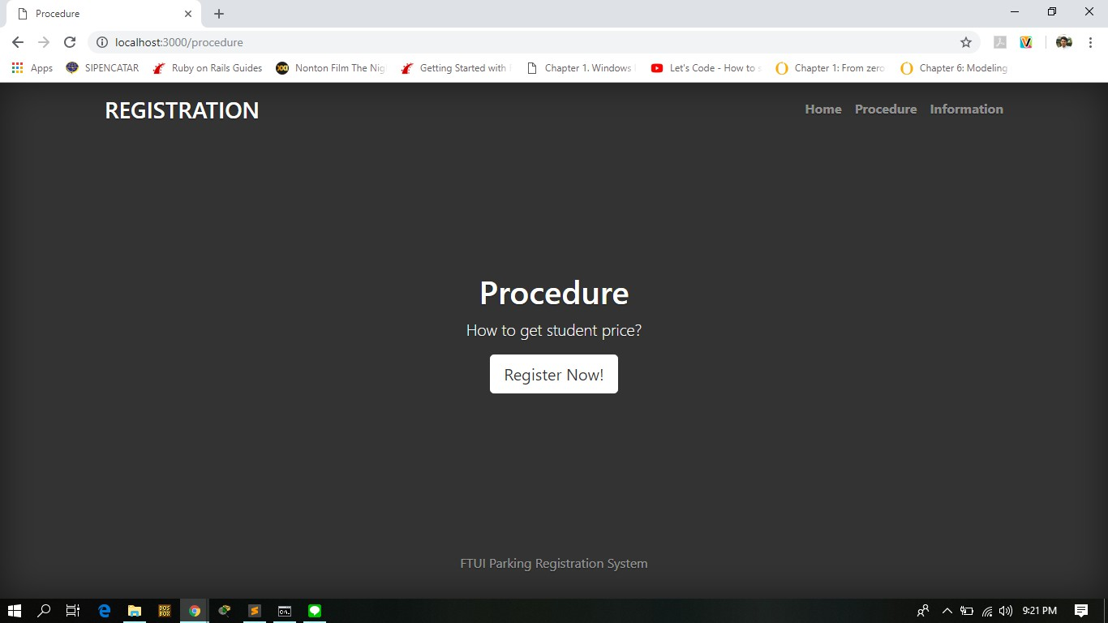
THANKS!

Slide 15
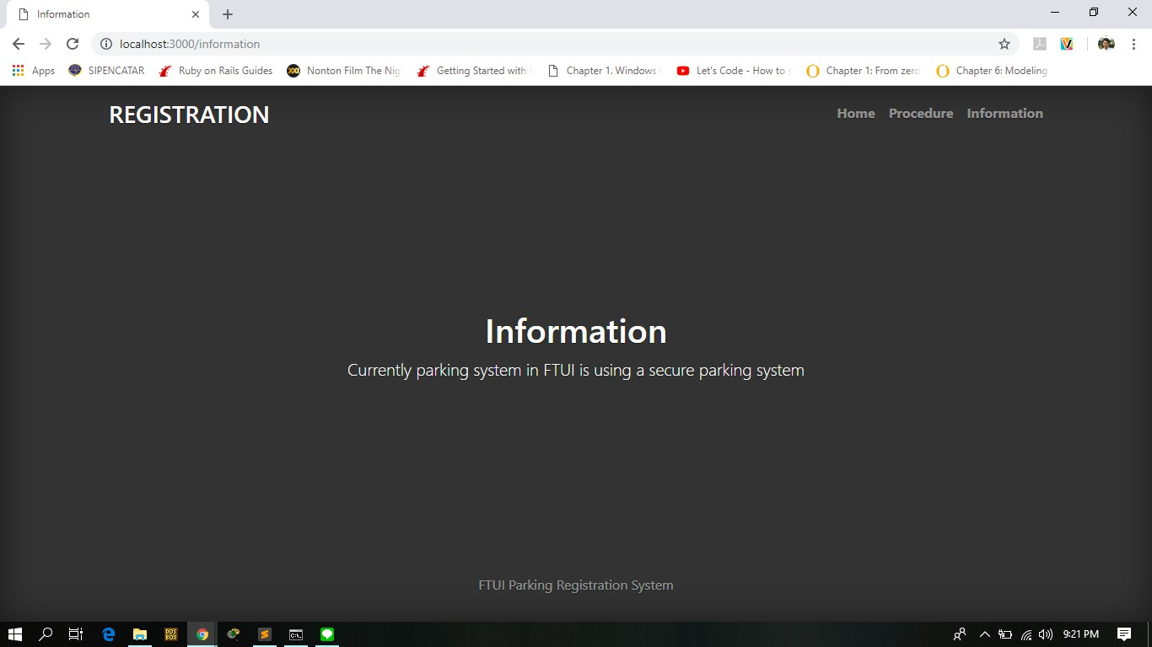
THANKS!

Slide 16
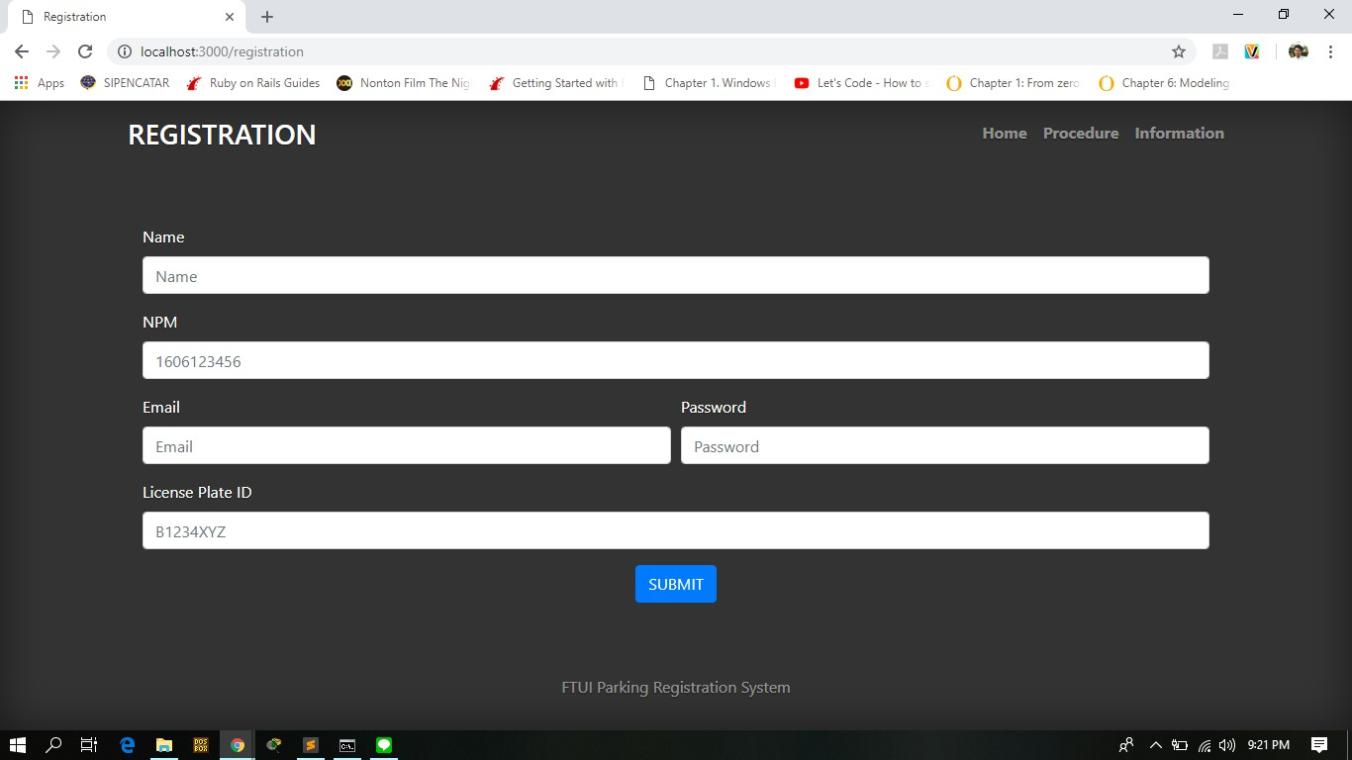
THANKS!

Slide 17
THANKS!

